Slide 1
Introduction to dynamical modeling of atomic and molecular systems
Ariel Norambuena
ariel.norambuena@usm.cl
Department of Physics
Universidad Técnica Federico Santa María

Slide 2

Outline
Two level systems
Harmonic perturbation
Lindblad master equation
Optical Bloch Equations (OBE)

Slide 3

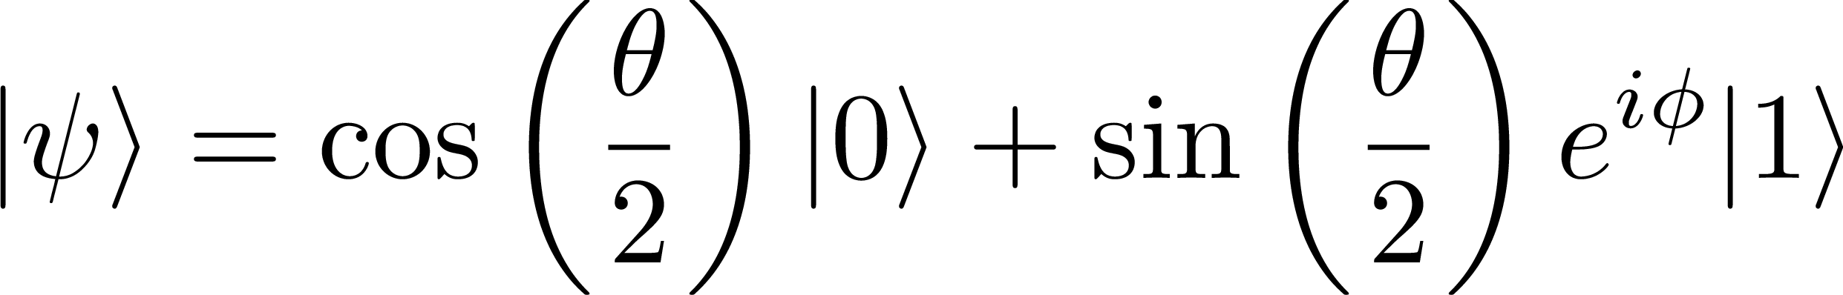



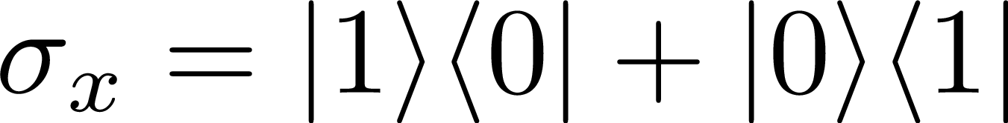

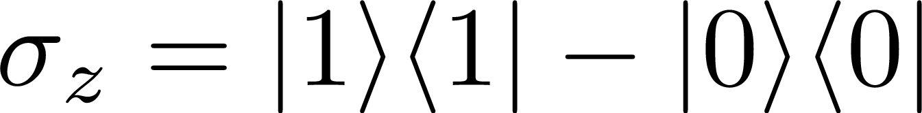

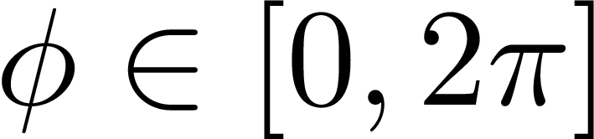


Notation
Computational basis
Bloch representation
Useful for…
Effective two-level systems in atoms or molecules
Physical qubits
Spin-1/2, superconducting qubits, neutral atoms
Bloch sphere

Slide 4
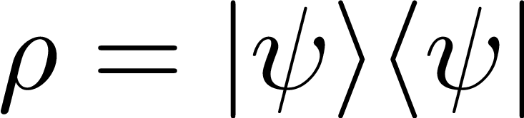
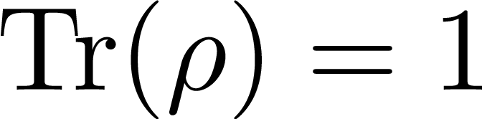
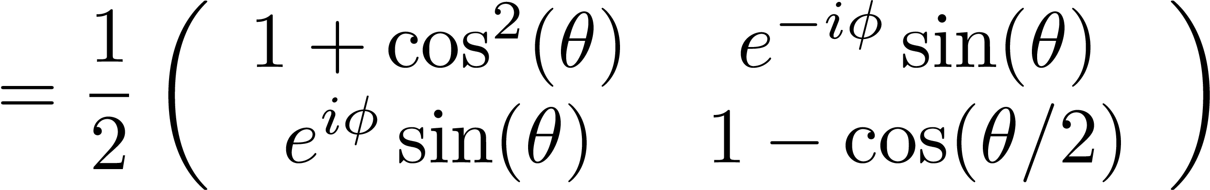
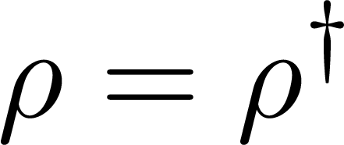

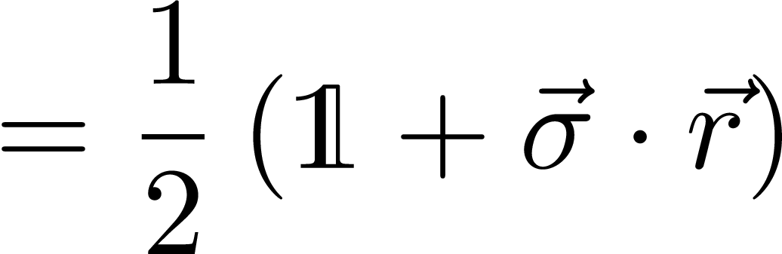
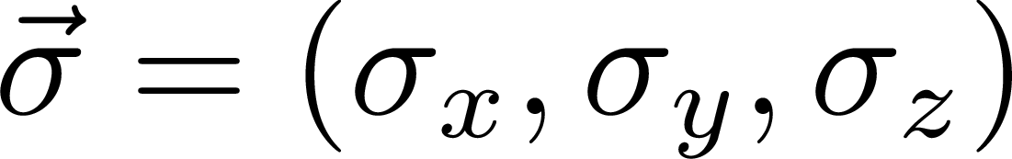
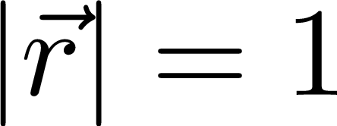
Density matrix for qubits
Pure states
1)
2)
3)
Pauli matrices

Slide 5
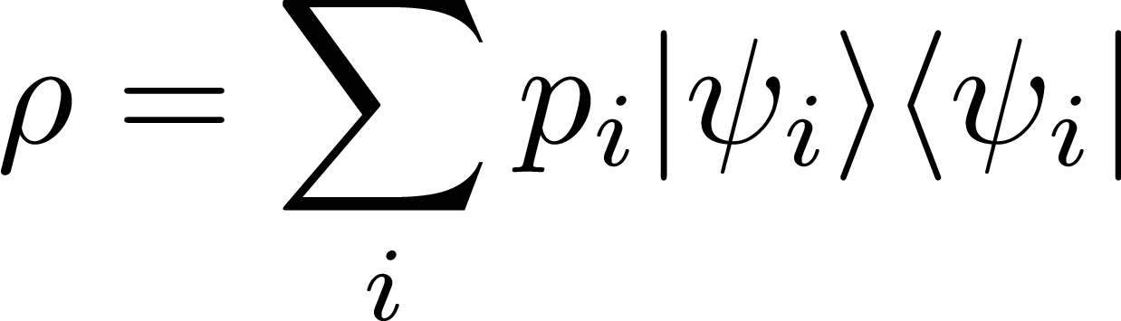
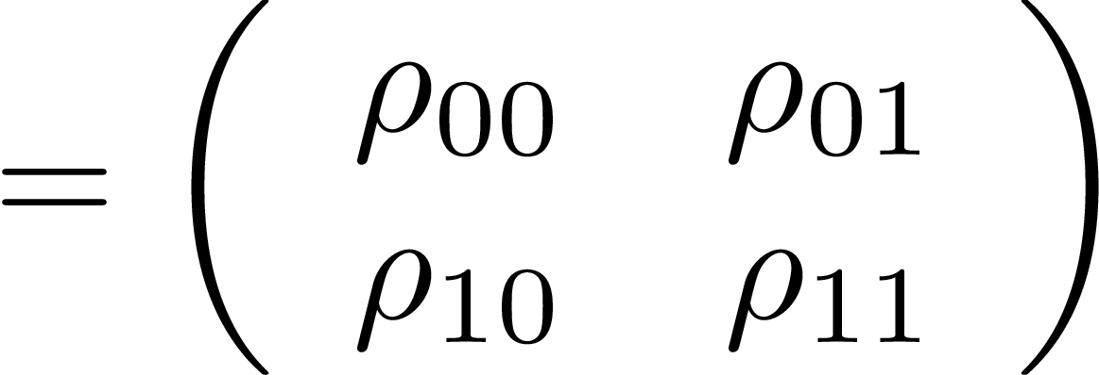
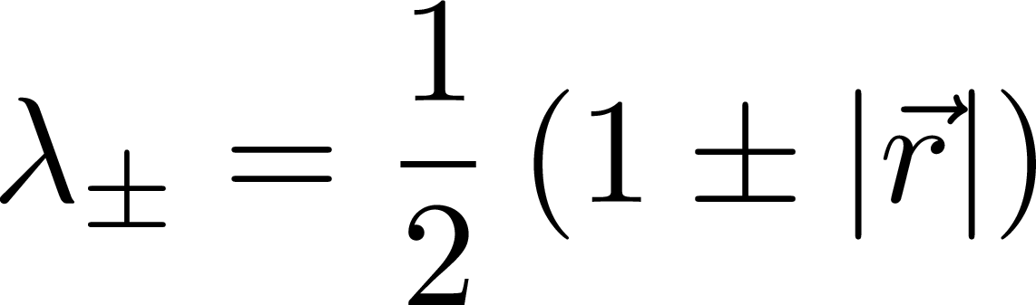
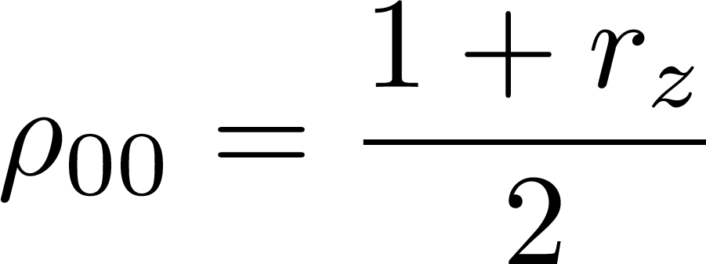
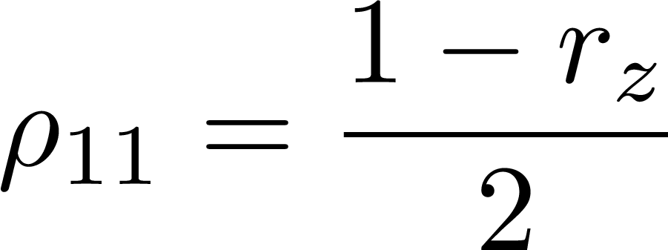
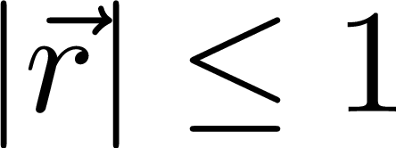
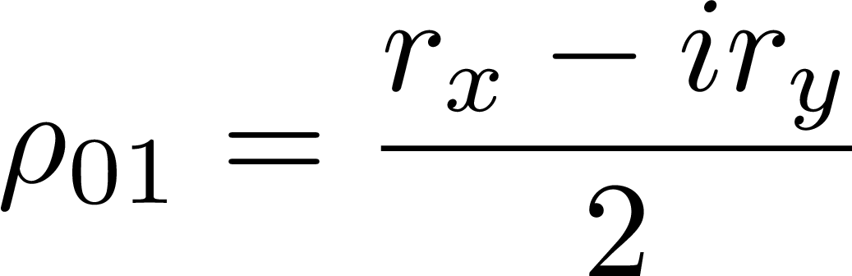
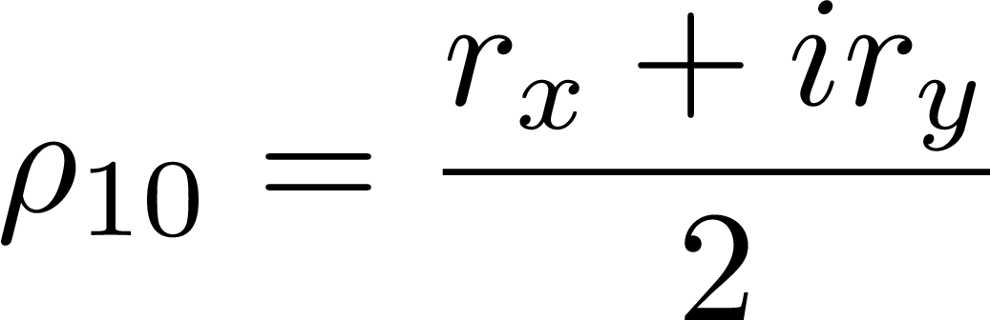
Density matrix for qubits
Mixed states
1)
2)
3)
Eigenvalues

Slide 6
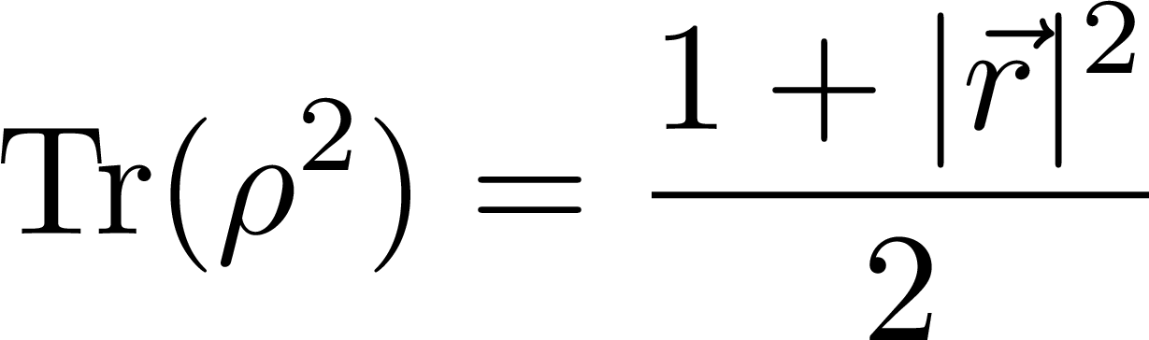
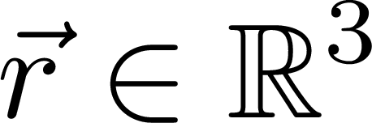
Density matrix for qubits
Pure states
Mixed states

Slide 7
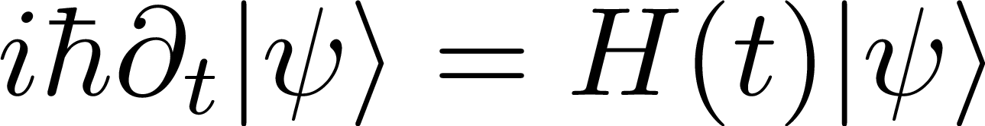
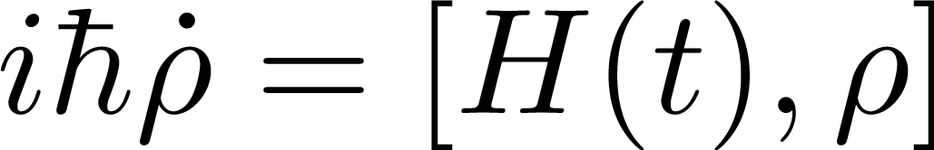

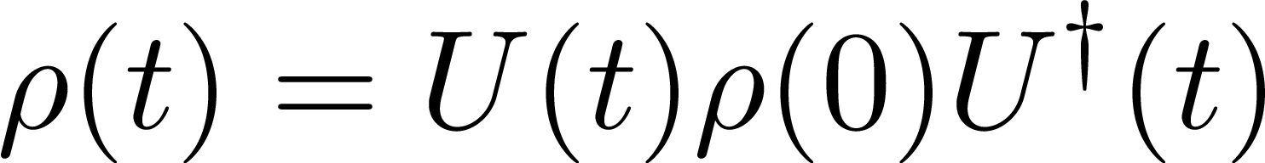
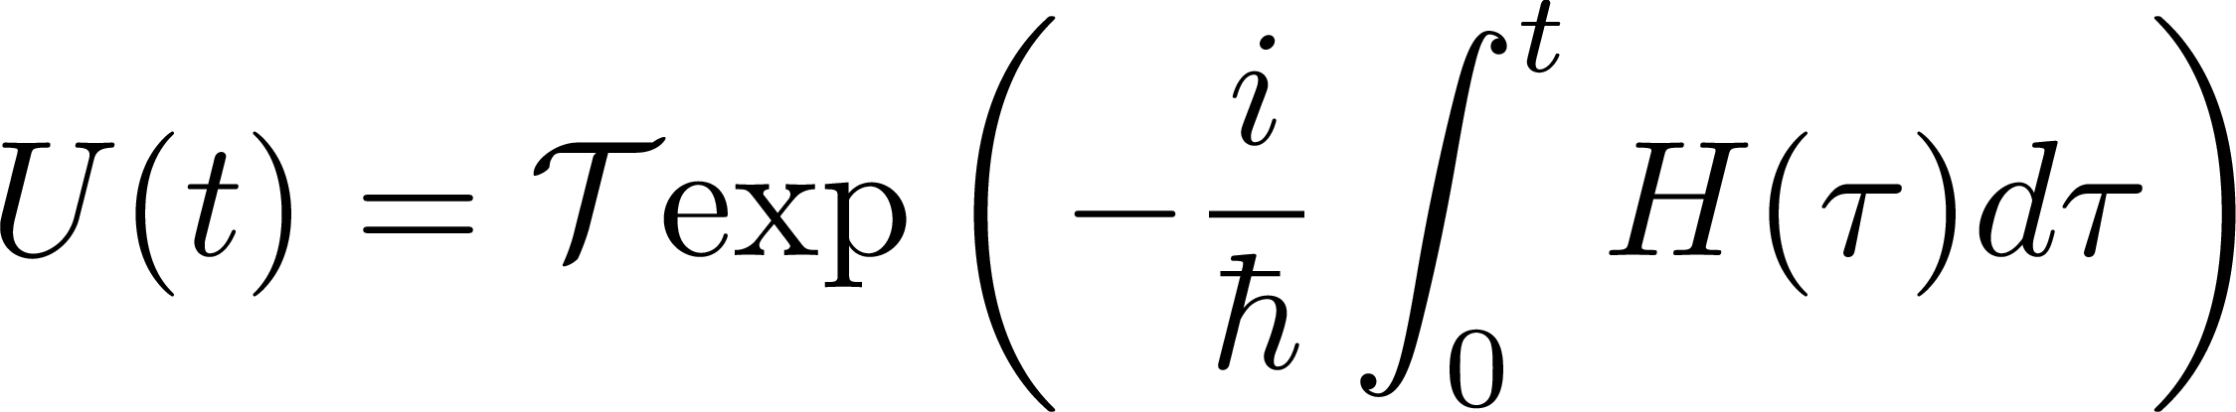
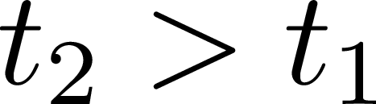

Closed dynamics for two-level systems
Schrödinger equation
Liouville equation
Exact solution
Exact solution
Time evolution operator
: time-ordering operator

Slide 8
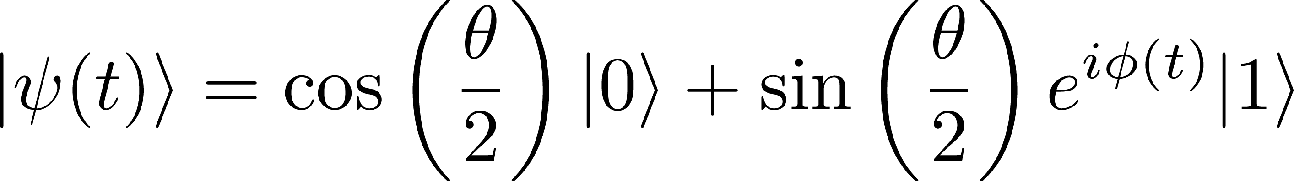
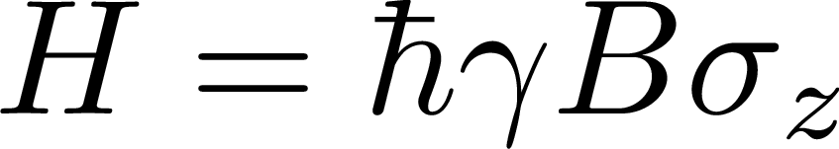

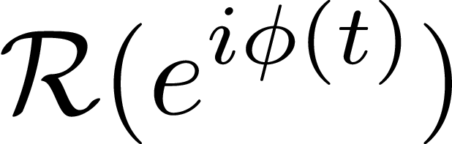
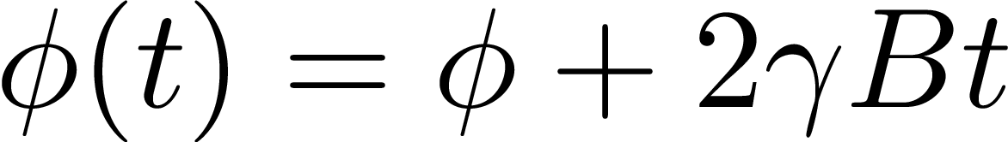

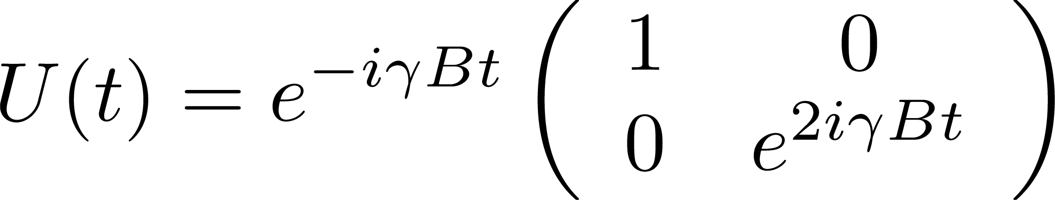


Example 1: magnetic field control
Hamiltonian
Wavefunction
Relevant
parameter
Evolution operator

Slide 9
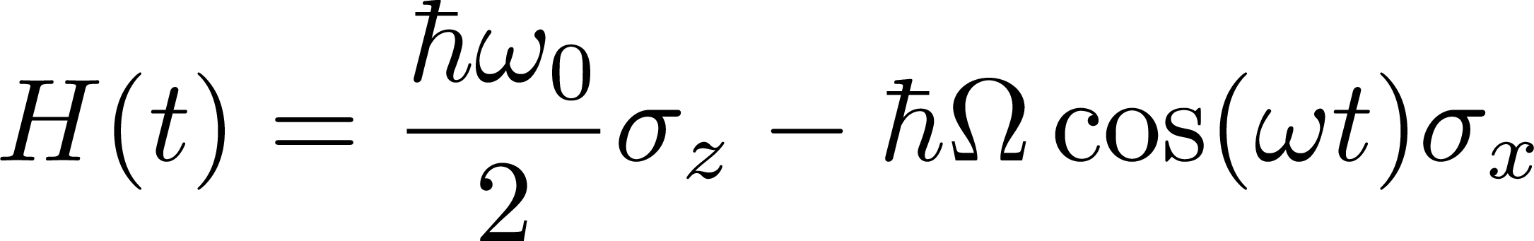
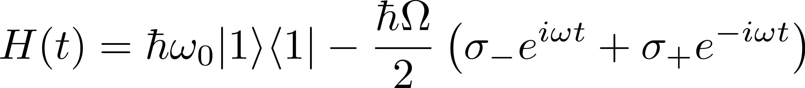
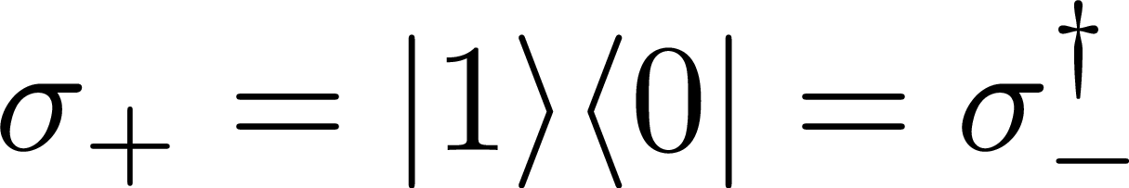





Harmonic perturbation
Spin 1/2 + microwave control
Atomic TLS + laser control
Rotating frame
Harmonic
perturbation
Idea: Find a reference frame to
simplify the physics

Slide 10


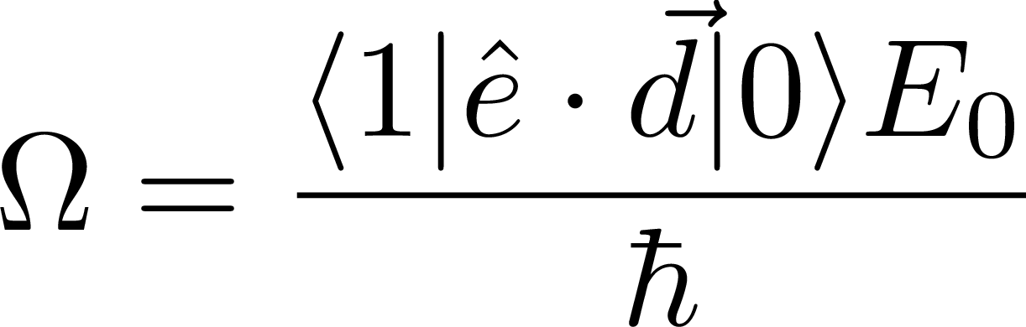
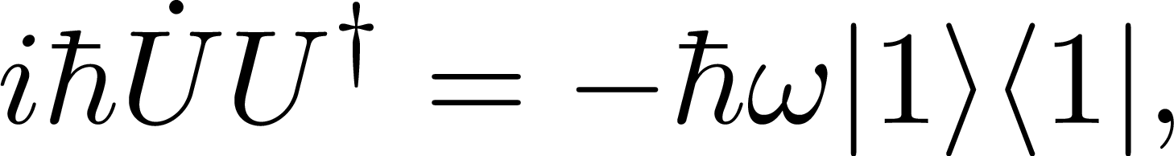

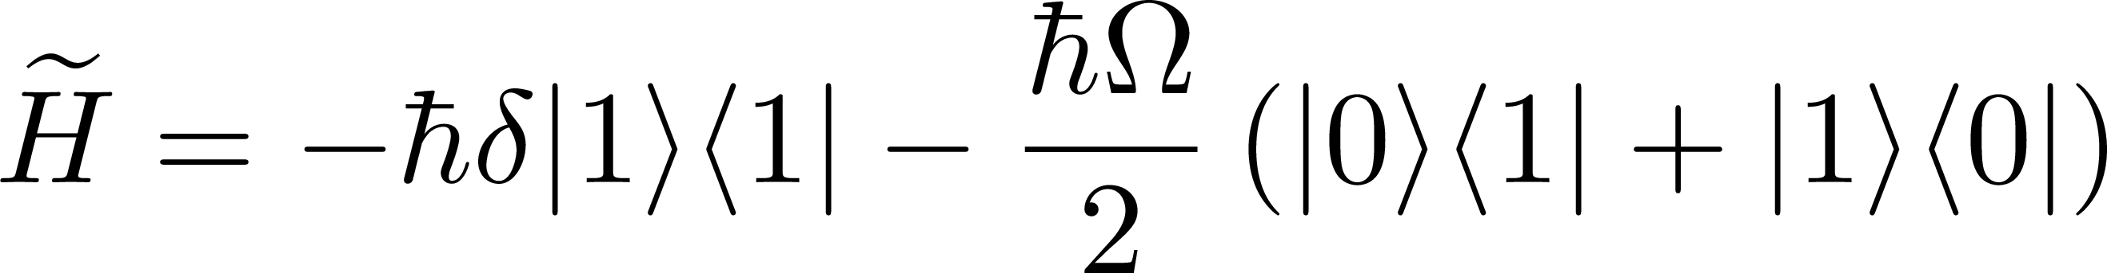
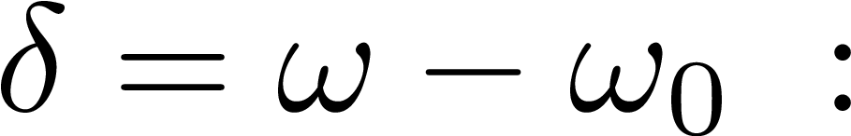

Example 2: atomic TLS with laser control
Atomic TLS + laser control
Unitary transformation
Transformed Hamiltonian
Relevant parameters
detuning
Rabi frequency

Slide 11
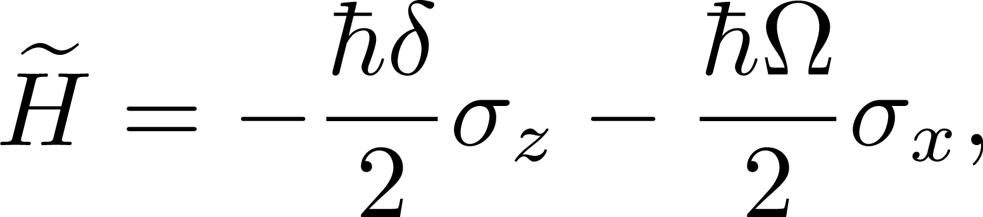

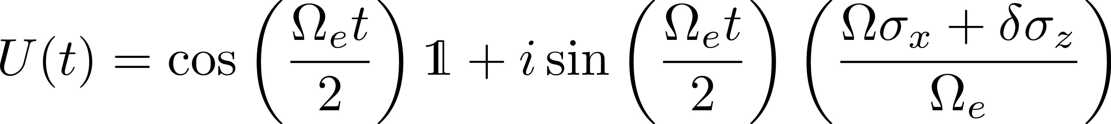
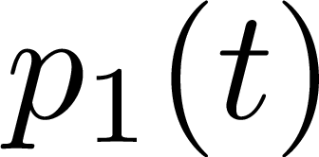

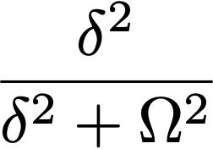
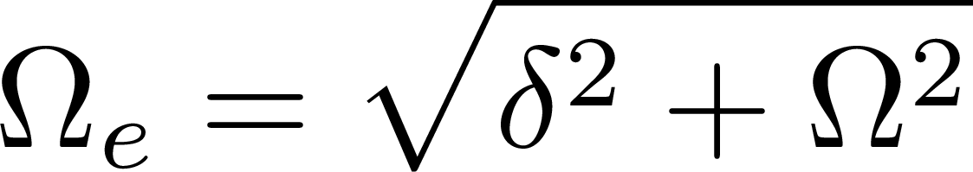
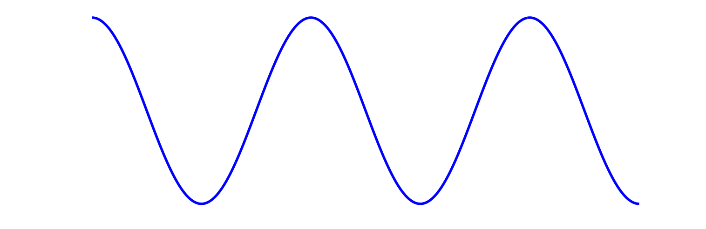
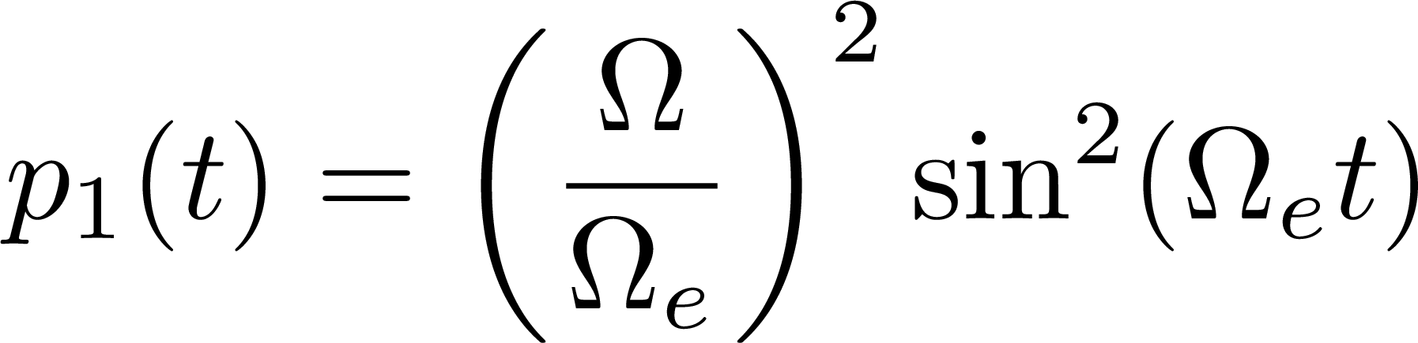


Exact solution harmonic perturbation
Transformed Hamiltonian
Microwave
Evolution operator
Effective Rabi frequency
Population excited state

Slide 12

Introduction: system and environment
Environment | Effect
Lattice / vibrations | Thermalisation Qubit initialisation
Nuclear and electronic spins | Decoherence Additional Qubits
Photons / Vacuum fluctuations | Spontaneous decay Spin-photon entanglement

Slide 13
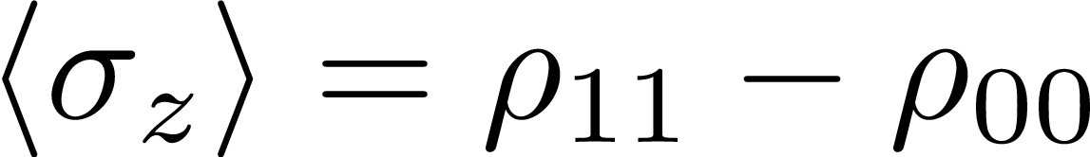

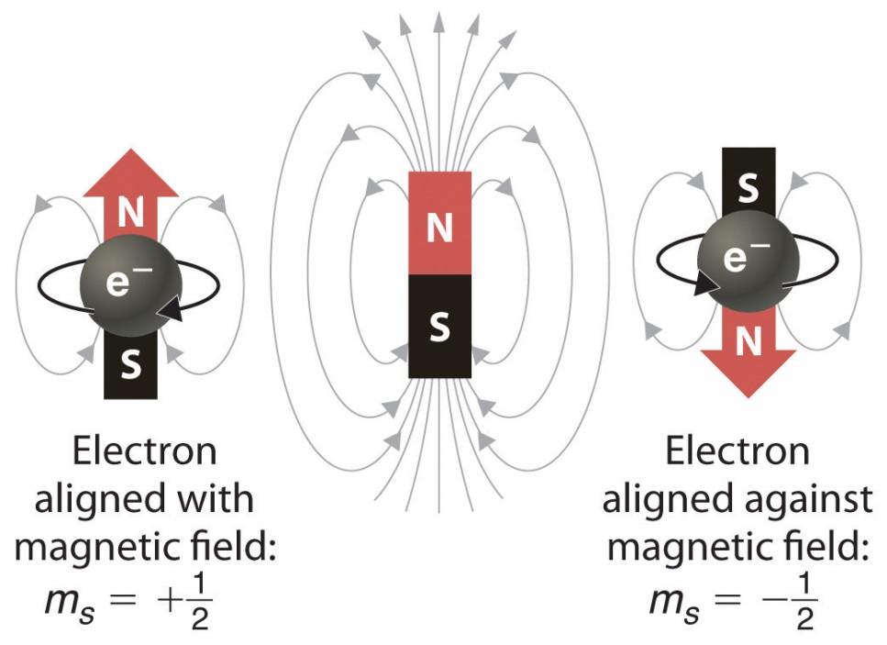

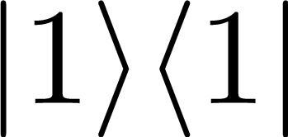



Closed spin dynamics
spin ½
Coherent oscillatation between
and

Slide 14
Open spin dynamics
spin ½ + environment
+
+
+
+
+
+
+
+
+
+
+
+
+
+
+
+
+
+
+
System: spin ½
Environment: magnetic impurities
The environment
induce dissipation

Slide 15



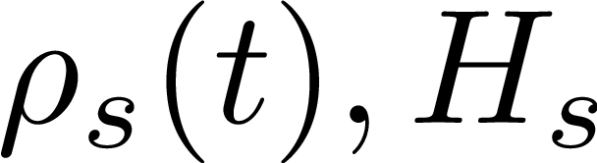
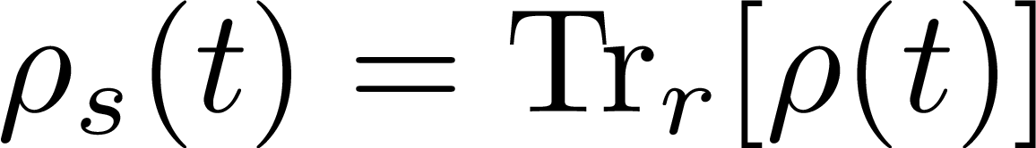
Open quantum systems
Environment
System

Slide 16



Lindblad master equation
Damping rates
quantum process: $L_{k}$
Closed dynamics induced
by the system Hamiltonian
Dissipative dynamics induced
by the system-reservoir interaction

Slide 17







Phase and amplitude damping
Phase damping (PD)
Amplitude damping (AD)

Slide 18








Optical Bloch Equations
TLS + harmonic perturbation
+ dissipation
: dephasing rate
: longitudinal rates

Slide 19














Steady states in OBE
Particular case:
Steady states
Low saturation
Saturation parameter
Strong saturation
Large detuning

Slide 20

References
Ariel Notes: Lectures on “Advanced Quantum Mechanics”, FIS 340-428
Quantum Mechanics FIS340-FIS428
Jero notes: “Atom Trapping”, 1st School on Ultracold Atoms, PUC, Santiago, 20 January 2025
Chapters 1 and 2

Slide 21
Thank you

